Slide 1
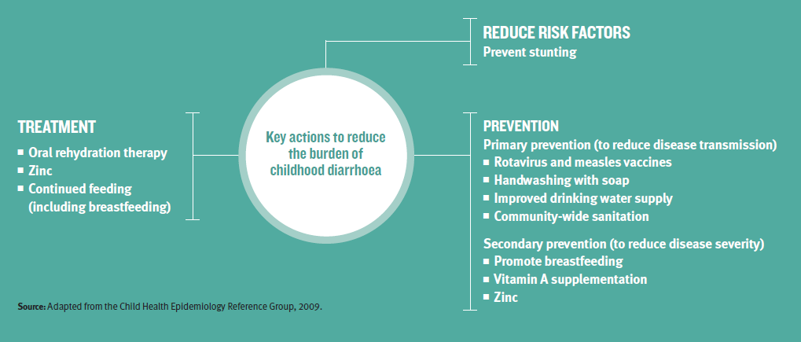
More proven interventions are available to prevent and treat diarrhea than any other major child killer
Jones G Bryce J. et al. Lancet. 2003
Investing in and implementing a package of health, nutrition, clean water, sanitation, and hygiene solutions will cut diarrhea deaths by 60%.
UNICEF. Diarrhoea: Why Children Are Dying. 2009.

Slide 2

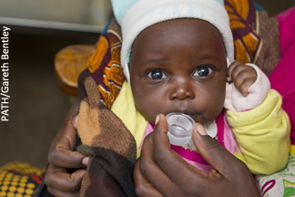
Dramatic effects of ORS
Oral rehydration therapy reverses dehydration in more than 90% of patients.
Since 1971, ORS has saved the lives of more than 50 million children.
If all parents could access and use ORS, diarrhea deaths would drop by a staggering 93%.
Gerlin A. A Simple Solution. Time. 2006.
Munos MK, et al. International Journal of Epidemiology. 2010.

Slide 3
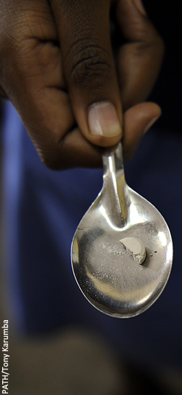
Zinc to prevent & treat
• 25% reduction in duration of acute diarrhea
• 29% reduction in duration of persistent diarrhea
• 40% reduction in treatment failure or death in persistent diarrhea
WHO recommends ORS and zinc for treatment of acute diarrhea
Increasingly included in national diarrhea control policies (Kenya, India, Vietnam, etc.)
Zinc Investigators’ Collaborative Group.
American Journal of Clinical Nutrition. 2000

Slide 4
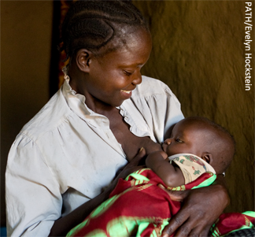
Breastfeeding protects
Breastmilk prevents death and stunting from malnutrition, helps develop the immune system, improves response to vaccines, and prevents infections like pneumonia and diarrhea.
Non-breastfed infants are 7X more likely to die from diarrhea
In Africa, Asia, and Latin America, less than half of infants younger than 6 months are exclusively breastfed.
UNICEF, WHO.

Slide 5
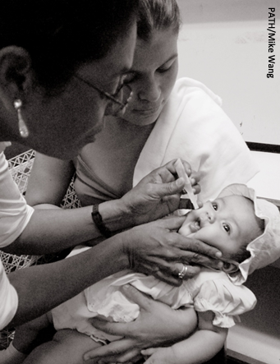
Rotavirus vaccination against deadliest diarrhea
Protection against the leading cause of severe childhood diarrhea; rotavirus is responsible for 1/3 of childhood diarrhea deaths.
Since 2006, rotavirus vaccines have been reducing hospitalizations and deaths caused by rotavirus—as well as deaths from diarrhea by any cause.
They also are protecting children and adults too old to receive vaccination, through herd immunity.
.dpuf
The World Health Organization recommends rotavirus vaccines be included in all national immunization programs.
WHO; UNICEF; Patel MM, et al. Journal of Infectious Diseases. 2011; Anderson E, et al. Clinical Infectious Diseases. 2013.

Slide 6
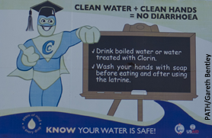
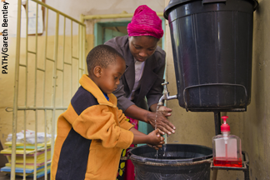
Water, sanitation & hygiene
More than 780 million people have no safe drinking water. But safe water for all could prevent almost 90% of diarrheal deaths.
Open defecation remains a major contributor to the fatal spread of diarrheal disease. 2.5 billion people have no sanitation facilities or latrines.
If all communities practiced universal handwashing, diarrhea risk would drop by nearly half.
UNICEF; UN; Greenland K, et al. What can hand hygiene do for the world? 2012.

Slide 7
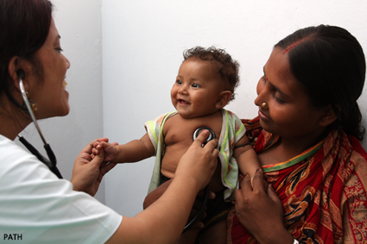
Diarrhea drug development
There are very few drug treatments for specific causes of diarrheal disease.
In low-resource settings, diarrhea is often inappropriately treated with antibiotics that are ineffective against many pathogens.
There is an urgent need for the development of safe, effective, and affordable drugs to treat infectious diarrhea.

Slide 8
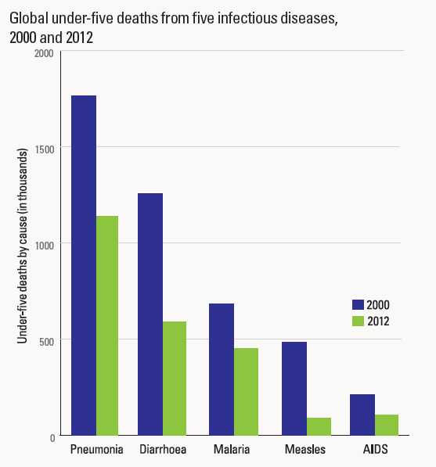
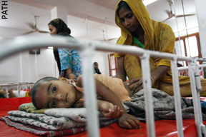
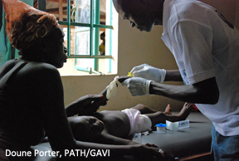
Childhood deaths are declining, but diarrhea is still a leading killer
UNICEF

Slide 9
But investment does not match the need
Policy Cures. Neglected Disease Research And Development: A Five Year Review. 2012.

Slide 10
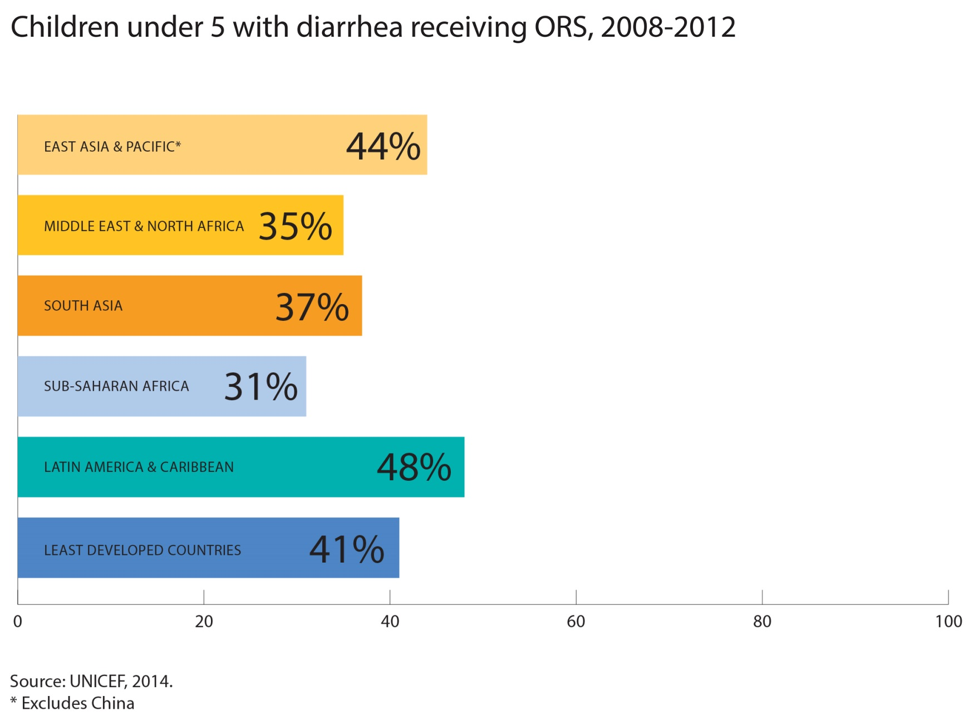
ORS coverage remains low in the most vulnerable communities
Source: UNICEF. State of the World’s Children
Notes:
Awaiting updated chart from graphics.

Slide 11

Diarrheal disease has failed to capture the attention of donors & policymakers
© PATH

Slide 12
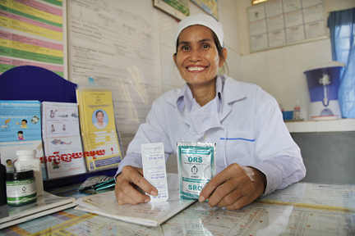
The potential of integration
Integrating proven, cost-effective prevention &
treatment solutions can
maximize impact
decrease expense
increase efficiency
At the policy level…
  One intervention – like rotavirus vaccines – can mobilize adoption of others
  Allows flexibility to design a package appropriate for a country’s needs
At the program level
  Combining interventions may offer efficiencies/cost savings
  Opportunity to strengthen health systems

Slide 13

Oral Rehydration Therapy
Vaccines
Zinc
Drug
Development
Sanitation/ Hygiene
diarrhea
Breastfeeding
Safe Water
deaths
Nutrition

Slide 14
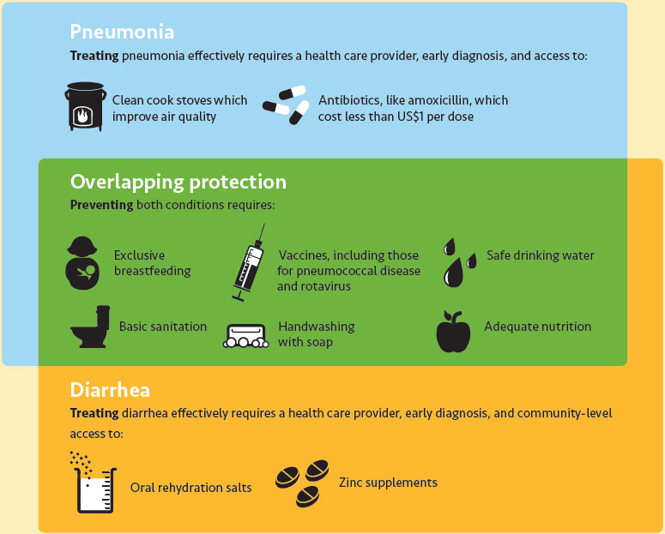
Integrating diarrhea & pneumonia strategies for major impact

Slide 15
The conversation is catching on
“It is unconscionable that in the 21st century, children still die of diarrhea. For me, it’s not complicated. We know what works and we should be doing more of it.”
- Chelsea Clinton; Vice Chair, Clinton Foundation
“A world where two million fewer children die from pneumonia and diarrhoea is achieveable because we already have the solutions.”
- Dr. Jim Yong Kim; President, World Bank
“A new integrated global action plan for the prevention and control of pneumonia and diarrhea … focuses on 15 highly effective interventions. When the[y] are put to work together, this is powerhouse that can revolutionize child survival.”
- Dr. Margaret Chan, Director, World Health Organization

Slide 16
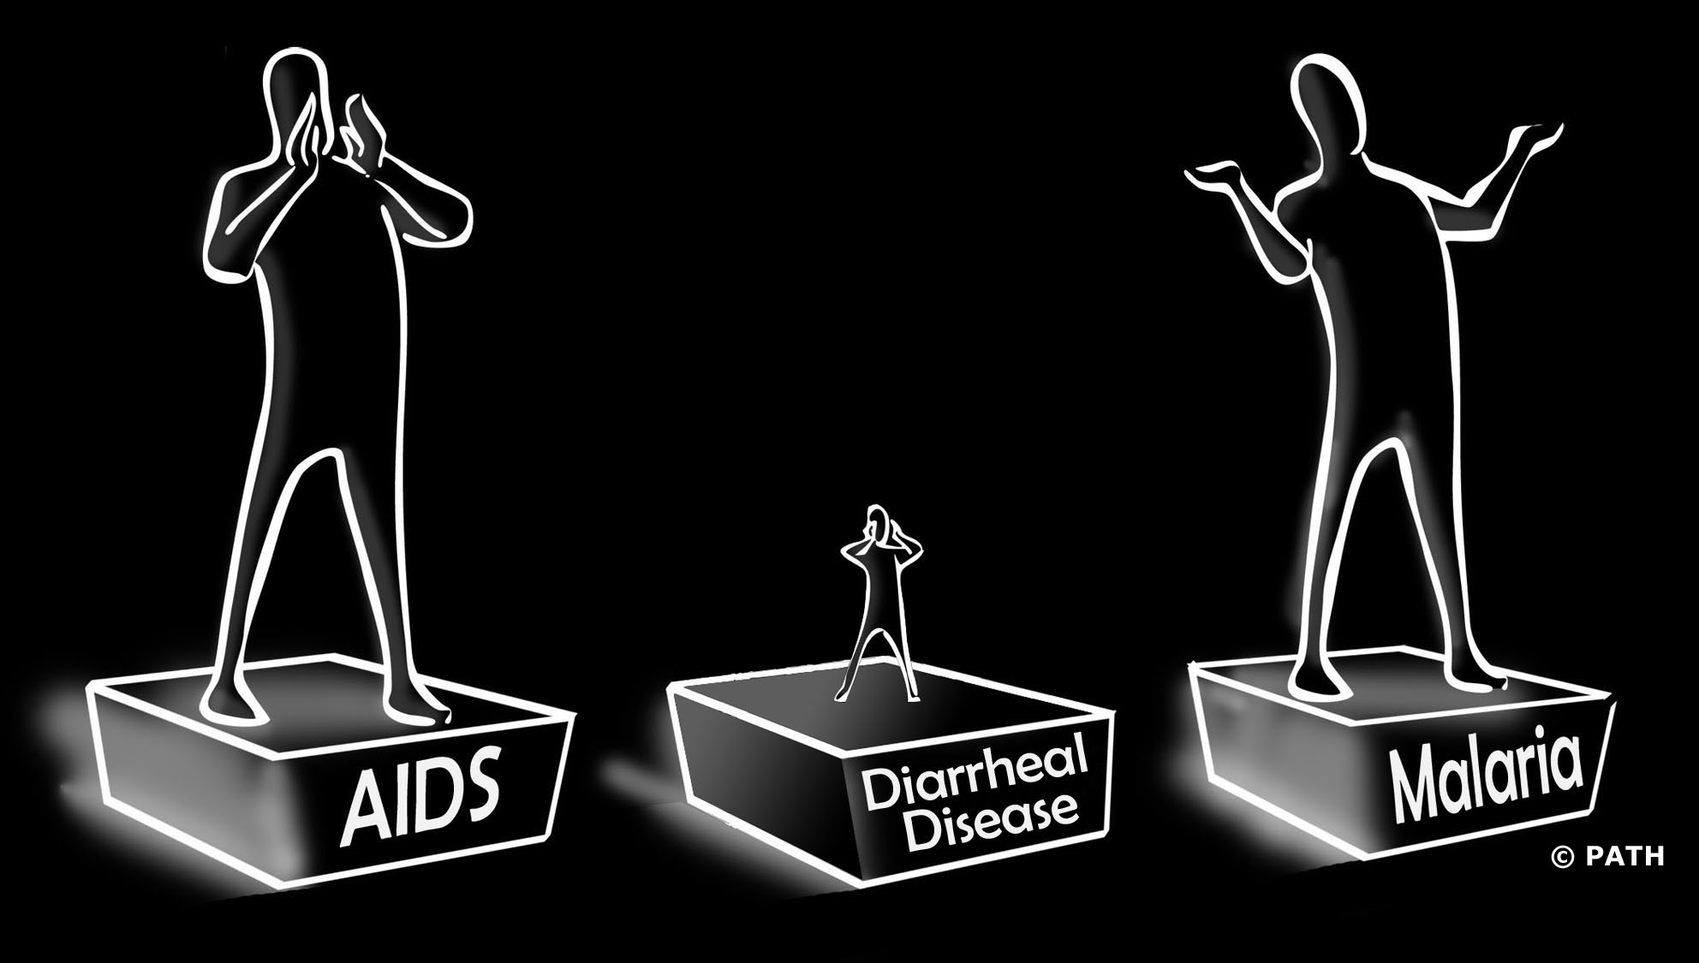
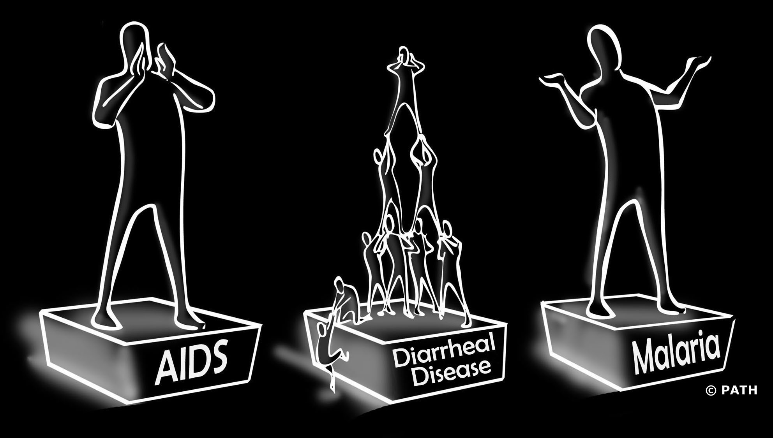
Together, we can make diarrheal disease a global health priority

Slide 17
Action Agenda:
  Support integration of tools & strategies to prevent and treat diarrheal disease
  (& pneumonia).
  Implement and document impact of integrated programs for the prevention and treatment of diarrheal disease.
  Communicate the evidence and data to policy-makers and funders.
  Speak out to raise awareness of the burden of diarrheal disease and the simple, cost-effective solutions to overcome it.

