Slide 1
Integrated Global Action Plan for Prevention and Control of Pneumonia and Diarrhoea (GAPPD)
Overview
[Insert Presenter Name Here]

Slide 2
In [insert country]…
Too many children are still dying from pneumonia and diarrhoea
Globally…
Pneumonia and diarrhoea are responsible for nearly one-third of deaths in children under five, claiming more than 2 million lives each year

Slide 3
By the numbers…
[Insert national diarrhoea and pneumonia mortality numbers here – check data from Countdown 2015 or A Promise Renewed Dashboard]

Slide 4

For the very first time…
There is a global plan to simultaneously tackle two of the leading killers of children: pneumonia and diarrhoea

Slide 5


Integrated Global Action Plan for the Prevention and Control of Pneumonia and Diarrhoea (GAPPD)
Released April 12
Developed by the World Health Organization and the United Nations Children’s Fund
Represents an integrated and intensified to reduce deaths and illnesses from pneumonia and diarrhoea

Slide 6
GAPPD Framework
PROTECT children
PREVENT disease
TREAT illness

Slide 7


PROTECT children with good health practices from birth by:
Breastfeeding exclusively for six months
Providing adequate complementary feeding
Supplementing with nutrients like Vitamin A

Slide 8





PREVENT children from becoming ill by:
Vaccinating against pertussis, measles, Hib, pneumococcal disease and rotavirus
Washing hands with soap
Improving access to safe drinking water and sanitation
Reducing household air pollution
Providing cotrimoxazole prophylaxis for HIV-infected and exposed children

Slide 9
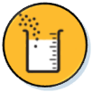


TREAT children who are ill by:
Improving care seeking and referrals
Leveraging case management at health facility and community levels
Using amoxicillin and oxygen to treat pneumonia, and using low osmolality oral rehydration solution and zinc to treat diarrhoea
Continuing feeding (including breastfeeding)

Slide 10
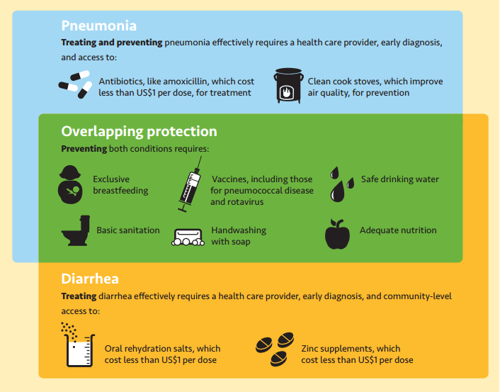
Integrated Solutions

Slide 11

In [insert country]…
We can use this action plan to set national priorities and increase focus on these two leading killers of children

Slide 12
Recent Success
[Insert examples of notable progress and recent successes, such as reduction of child mortality rates or an increase in the number of people with access to safe drinking water and sanitation]

Slide 13
GAPPD in [insert country]
[Use this slide to explain how the GAPPD is aligned with existing policies, commitments and government statements related to pneumonia, diarrhoea, child survival and MDG 4.
  If your government has signed on to A Promise Renewed, the GAPPD can be described as a concrete plan to help achieve that commitment. To check if your country has signed onto A Promise Renewed, visit: here.
  To see if your country has signed the pledge regarding the United Nations Commission on Life-Saving Commodities for all Woman and Children, check here for English or here for French.
  For additional insights on your country, check Countdown to 2015.

Slide 14
It is time to call on our government to…
Prioritise the fight against pneumonia and diarrhoea
Use the Global Action Plan to achieve the greatest health impact in [insert country] by determining:
  Government, civil society organisations (CSOs), and nongovernmental organisation actions
  Required resources
  Partners

Slide 15
It is time to call on our government to…
Engage key stakeholders, including:
  Affected communities
  CSOs/NGOs
  Private sector
  Donor agencies
  Multilateral institutions
  Identify effective programmes and where additional efforts are needed
  Coordinate efforts across ministries, sectors and partners

Slide 16
It is time to call on our government to…
Improve equity by allocating resources towards reaching those of greatest need
  Establish transparent governance structures to clarify:
    Roles
    Responsibilities
    Accountability
    [Insert country-specific call to action]

Slide 17

In [insert country]…
Coordinating our approach to fighting pneumonia and diarrhoea by using the GAPPD will:
Improve effectiveness and efficiency
Provide better services to communities, families and children
Save Lives

