Slide 1
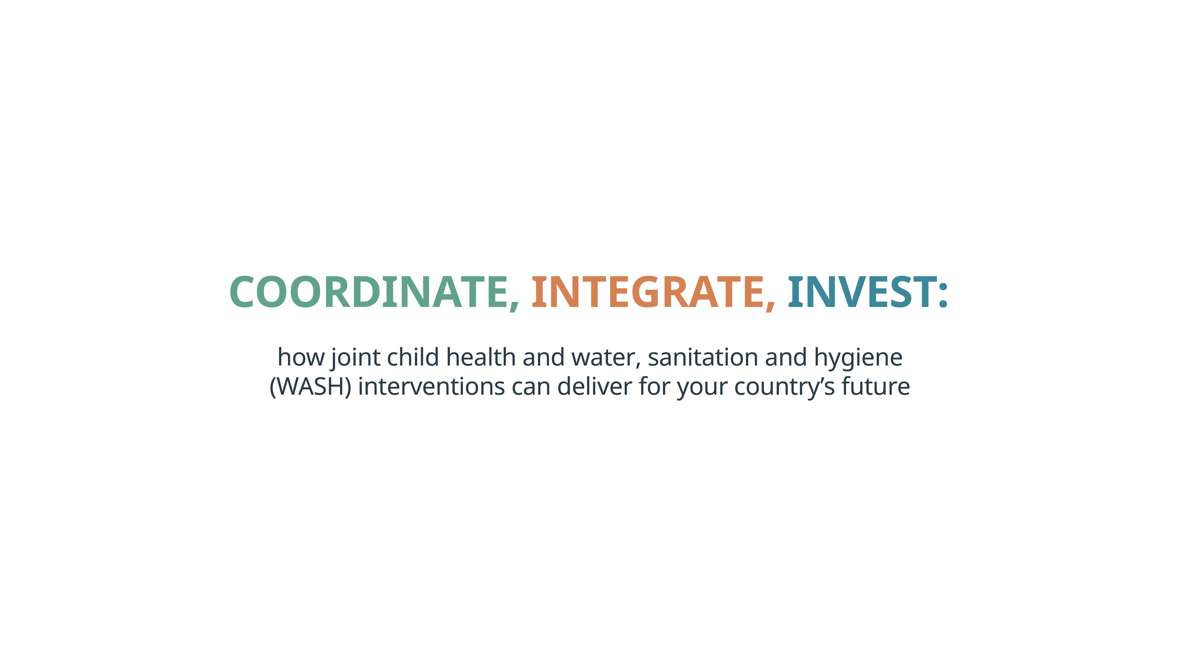
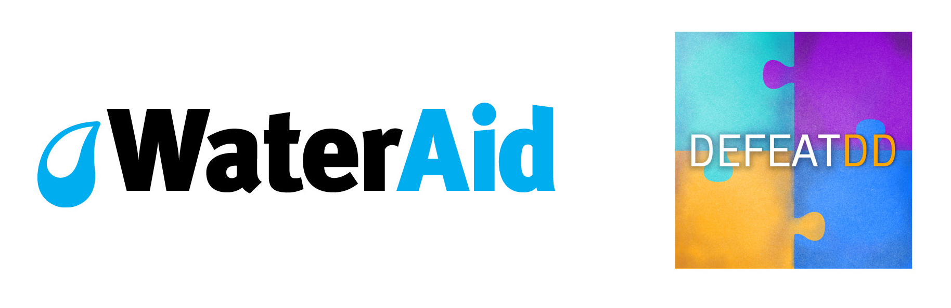
#DefeatDD
#HealthyStart

Slide 2



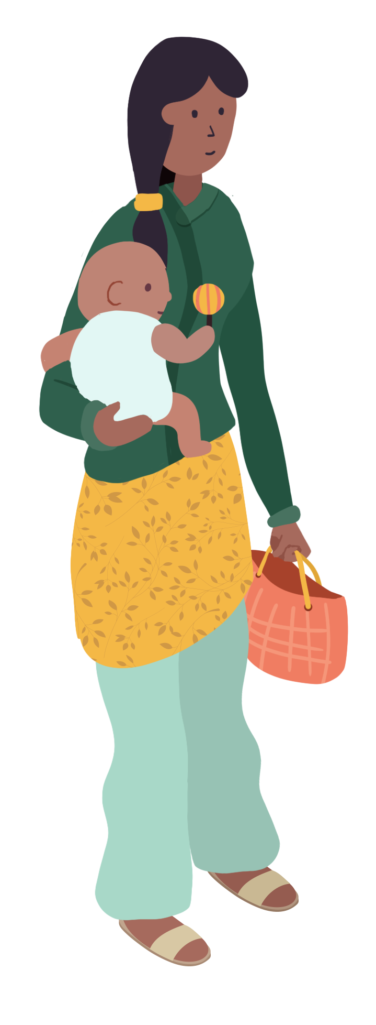

Investing in integrated actions in the early years of a child’s life creates a positive cycle that builds human capital, strengthens economies, reduces future healthcare costs and contributes to national development.
New analysis shows that major health gains and improved cost-effectiveness are possible if decision-makers act now to coordinate, integrate and invest in child health and WASH interventions.
Notes:
New analysis by PATH’s Defeat Diarrheal Disease (Defeat DD) Initiative and WaterAid…

Slide 3
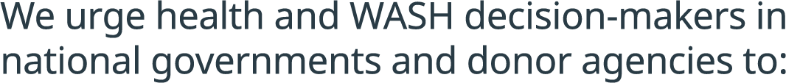


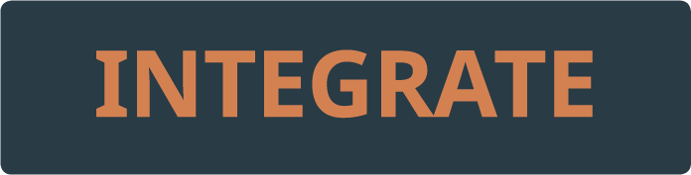

ACT NOW
Notes:
COORDINATE: Improve the coordination between ministries of health and ministries responsible for WASH, and between teams within donor agencies. Build a sense of shared ownership for shared outcomes.
INTEGRATE: Rapidly innovate, assess and scale up integrated programmes. Promising entry points include co-location of child health/nutrition and WASH interventions to areas and communities with multiple vulnerabilities, and integration of hygiene promotion within routine vaccination programmes.
INVEST: Put in place domestic and international financing that supports and incentivises an integrated approach. Donors need to champion and enable rapid experimentation around innovative integrated approaches.

Slide 4
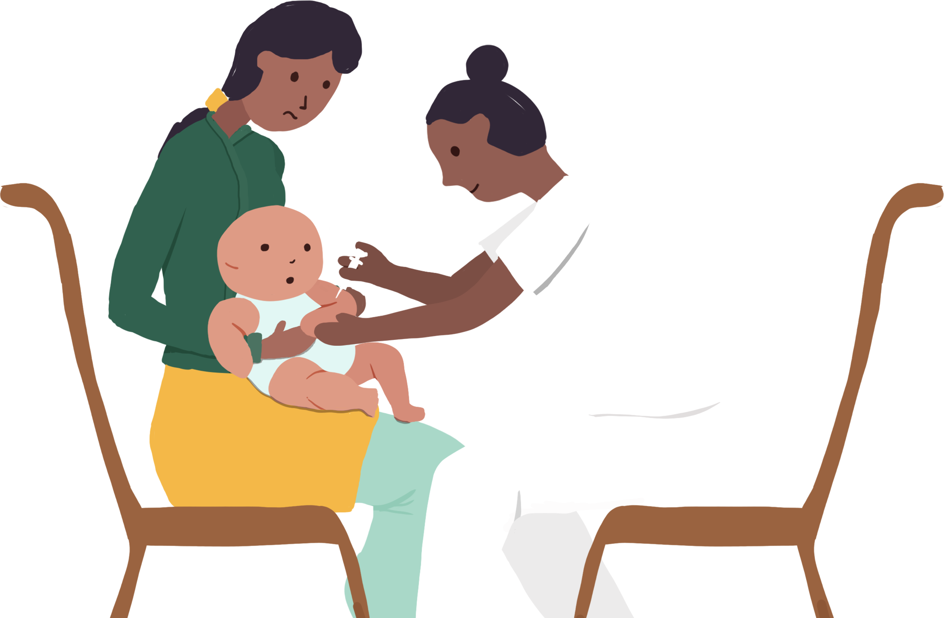

Opportunities for gains
OPPORTUNITIES
Scaling up an integrated package of WASH, rotavirus vaccination and nutritional interventions to 100% coverage.
Could potentially reduce morbidities by nearly two thirds (63%) and almost halve mortalities (49%)
from diarrhoea and pneumonia
– the equivalent of averting more
than 697,000 child deaths a year.
For every US$1 invested in water and sanitation globally.
A $4.3 return in the form of reduced healthcare costs.
Notes:
Scaling up an integrated package of WASH, rotavirus vaccination and nutritional interventions (breastfeeding promotion or zinc supplementation) to 100% coverage could potentially reduce morbidities by nearly two thirds (63%) and almost halve mortalities (49%) from diarrhoea and pneumonia – the equivalent of averting more than 697,000 child deaths a year.
For every US$1 invested in water and sanitation globally, there is a $4.3 return in the form of reduced healthcare costs. By expanding access to WASH and health services together, we can maximise impact and cost-effectiveness still further.

Slide 5

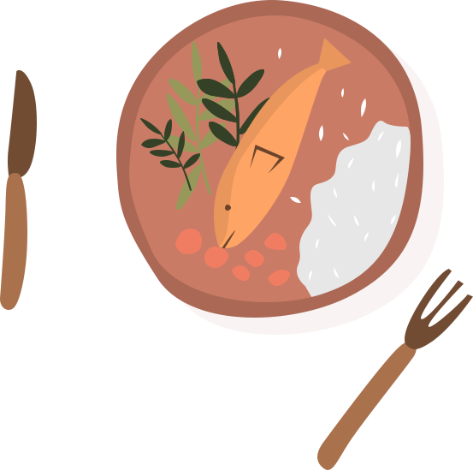
Opportunities for gains
OPPORTUNITIES
Integrated health and WASH interventions can have benefits
far greater than the sum of
their parts.
e.g. simultaneous improvements
in access to WASH services and healthcare together seem to
halve the probability of stunting compared with access to WASH alone.
Countries in Sub-Saharan Africa and South Asia that have not tackled child stunting are facing punishing economic losses of up
to 9–10% of GDP per capita.
Delivering integrated nutrition and WASH could help to create a more productive workforce and economic growth.
Notes:
Integrated health and WASH interventions can have benefits far greater than the sum of their parts. For example, simultaneous improvements in access to WASH services and healthcare together seem to halve the probability of being stunted compared with access to WASH alone.
Countries in Sub-Saharan Africa and South Asia that have not tackled child stunting are facing punishing economic losses of up to 9–10% of GDP per capita. Delivering integrated nutrition and WASH actions could help to create a more productive workforce and economic growth, lifting your country out of poverty.

Slide 6
WHY INTEGRATE?
289,000
children die every year from diarrhoeal diseases caused by poor WASH– one child every two minutes.
155 million children under five are stunted, their cognitive
and physical development damaged irreversibly by chronic malnutrition. Stunting is often connected to infections caused by
poor WASH.
Dirty water, inadequate sanitation and poor hygiene are closely associated with the leading causes of under-five child death (mortality) and illness (morbidity), including diarrhoeal diseases, pneumonia and malnutrition.
58% of child deaths from diarrhoeal diseases are caused by poor WASH.
1 in 3 people
(2.3 billion)
do not have a decent toilet.
An estimated half of all undernutrition is linked to infections caused by poor WASH.
More than
a third
of healthcare facilities in low- and middle-income countries do not have an improved water source.
Poor sanitation is the second biggest cause of stunting.
1 in 9 people
(844 million) don’t have clean water close to home.
Notes:
The Sustainable Development Goals (SDGs) ‘are integrated and indivisible’. But what does this mean in practice? Why integrate and take multi-sectoral approaches if these are more complex and less well defined? To answer this, we must look first at the challenge. The stark truth is that, despite progress in reducing poverty, and improving health and education, we have much more work to do to improve child health and access to WASH.
This is not solely about child deaths. The often invisible cost of poor WASH and health access is in the effects of recurring illnesses – impacts on children’s development that are often irreversible and cause life-long damage or disability. These effects prevent them from growing, learning at school and fulfilling their potential.
This creates an intergenerational cycle of poverty and ill-health – sick and malnourished mothers give birth to low birth weight babies who then suffer malnutrition and have impaired immune systems, and so the cycle goes on.
But a positive cycle is possible – integrating WASH and child health can lead to positive gains for future generations.

Slide 7
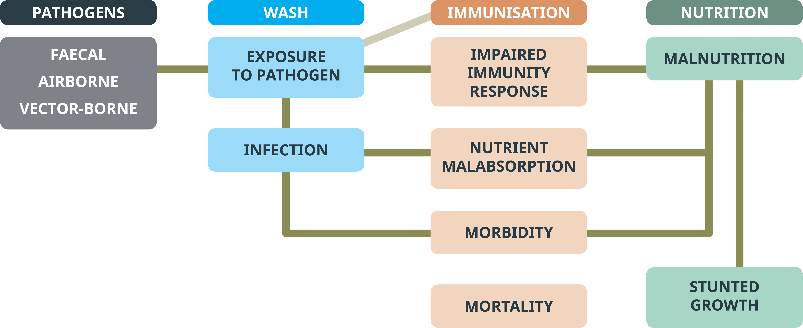


WASH–CHILD HEALTH PATHWAYS
Notes:
As these figures show, child health and WASH are closely interconnected through many direct and indirect pathways.

Slide 8
NOW IS THE TIME FOR ACTION
Notes:
People do not live their lives in sector-specific siloes.
The challenges people living in poverty face cross issues and sectors – and so must the solutions.
Integration is a two-way street and the onus must be on both the health sector and the WASH sector to come together.
It is the poorest families and communities who are most likely to face unacceptable conditions and be unreached by traditional approaches.
Integration is context-specific, not ‘one-size-fits-all’. However, it is no longer enough to talk about integration or to write policies advocating future improvements. Now is the time for action.

Slide 9

Act now to improve the coordination between ministries of health and ministries responsible for WASH, and between teams within donor agencies. Build shared ownership for shared outcomes.

Slide 10
Too often government ministries are acting in isolation, missing opportunities for improved coordination.
Donor agencies, NGOs and UN agencies, often similarly siloed, risk reinforcing the separation.
However, enhanced information-sharing, joint policy-making and coordinated planning are showing innovative approaches can be rapidly assessed and scaled up nationwide.
Notes:
Too often government ministries are acting in isolation to plan and deliver vertical interventions, and are failing to seize opportunities for improved coordination.
Donor agencies, NGOs and UN agencies, often similarly siloed into issue-based teams, risk reinforcing the separation.
However, experiences from across the world are beginning to show that, through enhanced information-sharing, joint policy-making and coordinated planning, innovative approaches linking interventions and sectors can be rapidly assessed and scaled up nationwide.

Slide 11


Example: Madagascar’s coordinated action to tackle malnutrition
The Government is strengthening coordination on malnutrition and WASH through the National Action Plan for Nutrition Phase III (2017-2021).
The plan:
Prioritises ‘nutrition-sensitive’
as well as ‘nutrition-specific’ interventions.
Aims to improve access to drinking water to 65% of households.
Aims to take a
multi-sector approach to reducing stunting from
47% to 38%
by 2020.
Aims to improve
access to sanitation to
30% of the population
and to promote good food and hand hygiene.
Notes:
Nearly half of children under five are chronically malnourished. Almost half of people lack access to safe water, and access to improved latrines is 12%.
To improve coordination, the Government of Madagascar intends to:
Strengthen the policy and regulatory environment governing nutrition.
Improve coordination mechanisms and align actions around a common results framework.
Increase mobilisation of internal and external resources.
Set up a multi-stakeholder consultation on WASH and nutrition.

Slide 12

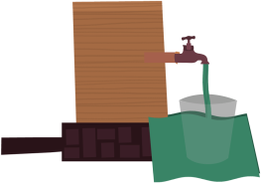
Example: Multi-sectoral action in Bahia state, Brazil
Multi-sectoral project – health, water, sanitation, public management, and planning, coordinated under the secretary of financing.
Government supported
by World Bank.
In ten municipalities with highest diarrhoea incidence and worst WASH infrastructure, the project:
increased the number of people served with basic water and sanitation
trained community health agents in environmental control, hygiene, and WASH management
used scorecards and incentives to improve household sanitation and hygiene behaviours
improved monitoring of water quality along with river basin planning
increased the coverage of family health teams
increased rotavirus vaccination in children younger than one year
Notes:
This multi-sectoral project was a major success for Bahia. From 2008–2015, the state recorded a 70% reduction in hospitalisations for diarrhoea of children younger than five, along with a 40% reduction in the infant mortality rate.

Slide 13

Act now to rapidly innovate, assess and scale up integrated programmes. Promising entry points include co-location of child health/nutrition and WASH interventions to areas and communities with multiple vulnerabilities; and integration of hygiene promotion and routine vaccination programmes.

Slide 14
Proven interventions exist.
WHO and UNICEF guidance is to integrate prevention and treatment solutions for diarrhoeal diseases and pneumonia, e.g. WASH, vaccines, breastfeeding and nutrition, and treatment such as ORS and zinc or antibiotics.
Integrating WASH with child health interventions can multiply the improved health outcomes many times over, while reducing costs.
Notes:
Proven interventions exist to tackle leading causes of child death and illness.
E.g. Defeat DD’s ‘State of the Field’ report 2017 highlights the need to integrate proven prevention and treatment solutions for diarrhoeal disease e.g. WASH, vaccines, breastfeeding, oral rehydration solution and zinc.
Our new analysis, together with work by the World Bank and others, reinforces the case that integrating WASH with child health interventions can multiply the improved health outcomes many times over, while reducing costs.

Slide 15
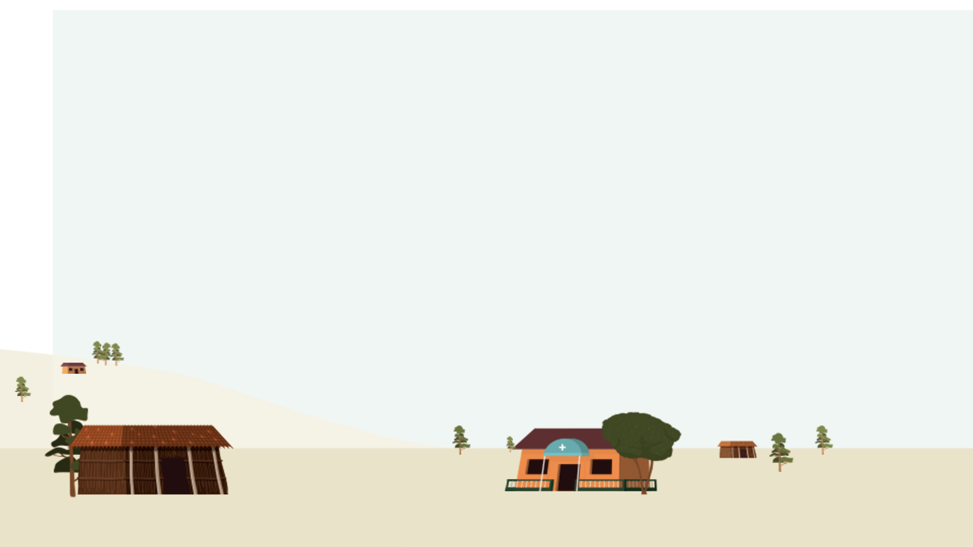
Scaling up an integrated package of WASH, rotavirus vaccination and nutritional interventions (breastfeeding promotion or zinc supplementation) to 100% coverage could potentially reduce morbidities by nearly two thirds (63%) and almost halve mortalities (49%) from diarrhoea and pneumonia – the equivalent of averting more than 697,000 child deaths a year.
The multiplier effect of pairing health and WASH interventions could be substantial, e.g. rotavirus vaccination integrated with hygiene promotion could lead to nearly twice the reduction in child morbidities and nearly five times the reduction in mortalities than could rotavirus vaccination alone.
Simultaneous improvements in access to WASH services and healthcare together seem to halve the probability of stunting compared with access
to WASH alone.
Notes:
In an analysis for PATH and WaterAid, the impact of WASH interventions on children’s diarrhoea and pneumonia was quantified using comparative risk assessment, a widely used approach in Lancet Global Burden of Disease studies.
The analysis also assessed the impact of integrating water, sanitation and hygiene (individually and together) with breastfeeding promotion, zinc supplementation and immunisation against rotavirus, pneumococcal, and Hib (Haemophilus influenzae type B).
To quantify the impact of WASH and WASH–health integration, the study determined the proportion of global morbidities and mortalities from diarrhoea and pneumonia attributable to the lack of the interventions. The joint impact of integrated interventions was defined as the product of the effects.
Although this single analysis is an estimate and should be treated with caution, its findings parallel those of others in concluding that integrated interventions can have greater health benefits than can the sum of each separate intervention.

Slide 16
Co-location – an entry point
Improve joint targeting of health, nutrition and WASH to communities and areas with multiple vulnerabilities.
Evidence from the World Bank in Indonesia and Mozambique shows that children are more likely to be stunted, or to die from diarrhoea, where they are exposed to multiple exposure and susceptibility factors.
The Bank urges decision-makers to use geospatial mapping to prioritise and target interventions.
Notes:
The World Bank’s work highlights that one clear entry point for integration is to improve the joint targeting of health, nutrition and WASH interventions to communities and geographical areas with multiple vulnerabilities.
In Indonesia, the Bank estimates that children are 11% more likely to be stunted if living in communities with higher levels of open defecation.
In Mozambique exposure to inadequate WASH and other susceptibility factors (lack of access to vitamin A and ORS and being underweight) combined increases the risk of child mortality due to diarrhoea.
The Bank urges decision-makers to use geospatial mapping to prioritise and target interventions.

Slide 17






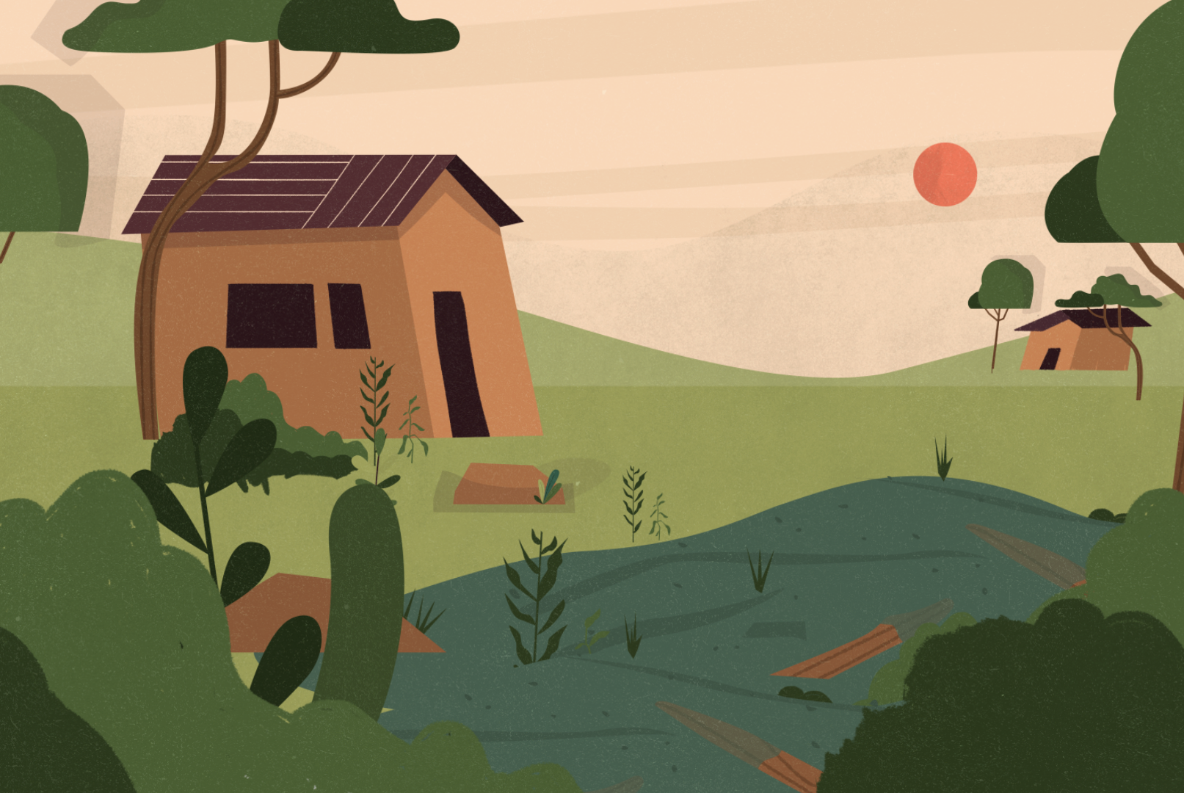

Tackling undernutrition through integration
Prioritise babies and mothers
Establish
a strong enabling environment
Promote comprehensive hygiene behaviours
Target the same geographical areas
Ensure all health centres and schools have WASH facilities
Notes:
Drawing on collaboration between the Scaling Up Nutrition (SUN) Movement and Sanitation and Water for All (SWA) partnership, Action Against Hunger, the SHARE Consortium and WaterAid recently articulated a potential ‘recipe for success’ for integration of WASH and child nutrition interventions to tackle undernutrition.
Based on an analysis of national nutrition and WASH policies and plans, the report summarises a ‘toolkit for integration’, which highlights several promising entry points:
Establish a strong enabling environment characterised by joint policy-making and strong cross-ministerial and multi-stakeholder coordination, underpinned by leadership and convening power from the highest level of government.
Prioritise babies and mothers as the target group for whom good nutrition is most critical to development, including through ‘BabyWASH’ interventions.
Target the same geographical areas with WASH and nutrition actions – those with high rates of undernutrition and low access to WASH
Promote comprehensive hygiene behaviours including complementary food hygiene, handwashing with soap at critical times and safe disposal of child faeces.
Ensure all health centres and schools have the WASH facilities they need to deliver nutrition and health services, and educate frontline health workers, teachers and caregivers in the intersections between health, nutrition, education and WASH.

Slide 18

Integrating hygiene promotion and routine vaccination programmes
Use roll out of routine vaccination programmes to promote behaviours such as handwashing with soap and good food hygiene alongside promotion of exclusive breastfeeding of infants.
There is increasing recognition that vaccine efficacy can be weakened in children with enteric infections caused by poor WASH. At the same time, integrating hygiene promotion can reduce mistrust in the immunisation programme, improve uptake of routine vaccines and strengthen health systems.

Slide 19
Example: Nepal integrates hygiene within rotavirus vaccination roll out
New mothers visit immunisation clinic
at least five times in child’s first nine months.
The hygiene promotion intervention improved
all key hygiene behaviours from 2% to 54%.
The female community
health volunteers promote hygiene behaviour change
and improved health.
It also increased immunisation coverage ‒ reducing drop out and vaccine wastage rate ‒ and helped to reach the un-reached population.
Pilot project ran in four districts and is now in transition to scale-up phase.
Notes:
In Nepal, a new mother will take her baby to an immunisation clinic at least five times in the first nine months of the child's life – making these clinics an excellent point of contact for promoting hygiene behaviour change and improved health.
By embedding hygiene promotion in Nepal’s existing routine immunisation programme, this innovative project is revolutionising how the hygiene and public health sectors work together.
The pilot intervention ran from February 2016 to June 2017 in four districts – Bardiya, Jajarkot, Myagdi and Nawalparasi – and is now in transition to the scale up phase.
An independent evaluation shows that the hygiene promotion intervention was effective in improving all key hygiene behaviours (from 2% at baseline to 54% after one year of implementation) as the primary outcomes of interest, as well as increasing immunisation coverage, reducing drop out and the vaccine wastage rate, and helping to reach the un-reached population as secondary outcomes.

Slide 20
Act now to put in place domestic and international financing that supports and incentivises an integrated approach. Donors need to champion and enable rapid experimentation with innovative integrated approaches.

Slide 21
Plans integrating child health and WASH must be backed up by the necessary financing.
The long-term sustainable results of integrated approaches could be transformational in getting a country on track towards prosperity.
Donors have a key role to play.
Notes:
Too often national governments shy away from a more integrated approach because of institutional barriers, territorial battles between ministries, or rigid, inflexible financing.
Another source of hesitation is that integrated approaches focus less on quickly counted outputs such as numbers of children vaccinated or who received zinc supplementation, and more on measuring health impacts, which takes longer.
However, long-term sustainable results could be transformational in getting a country on track towards prosperity.
Donors have a key role to play in incentivising and enabling the governments they support to embrace a cross-sectoral, integrated approach. Donors need to champion and enable rapid experimentation with innovative approaches, allowing flexibility to trial these in pilot projects and test multiple approaches.

Slide 22
The Global Financing Facility – an opportunity to finance integration?
The Global Financing Facility (GFF) model emphasises a country-led approach to improve reproductive, maternal, newborn, child and adolescent health and nutrition.
The GFF investment case process is ‘rooted in a multisectoral perspective’. As such, it could finance more integrated WASH–health approaches.
The GFF highlights two countries using financing to combine WASH and health/nutrition measures – Tanzania and Democratic Republic of Congo.
With the GFF soon to hold its first major replenishment, and with plans to expand, we urge governments and donors to capitalise on this opportunity to finance effective integration of WASH and child health.
Notes:
Launched by the UN in partnership with the World Bank in 2015, the Global Financing Facility (GFF) is described as the financing arm and implementation platform of ‘Every Woman Every Child’.

Slide 23
ACT NOW
For the SDGs to become reality requires bold action and new thinking, beyond traditional siloes.
The children of today, and the economies of tomorrow, depend on governments and donors acting urgently to strengthen coordination, integration and investment in child health and WASH.
We urge decision-makers to act now with ambition and innovation to forge a path towards health and prosperity for all, leaving no-one behind.

Slide 24
#DefeatDD
#HealthyStart
Read the report
www.washmatters.wateraid.org/integrate-for-health
www.DefeatDD.org

